Slide 1
Title IX
Pregnancy or Parental Status
Adrian Sora
Title IX, Deputy Coordinator for Pregnancy Services
One College Centre, Room 1473
254.298.8328
August 22, 2017

Slide 2
Temple College Policy
Title IX of the Education Amendments of 1972 (“Title IX”), 20 U.S.C. §1681 et seq., is a Federal civil rights law that prohibits discrimination on the basis of sex—including pregnancy and parental status - in educational programs and activities. This policy pertains to student rights under Title IX Pregnancy Services and to the respective course of action the student may choose to elect.
URL: http://catalog.templejc.edu/content.php?catoid=10&navoid=396

Slide 3
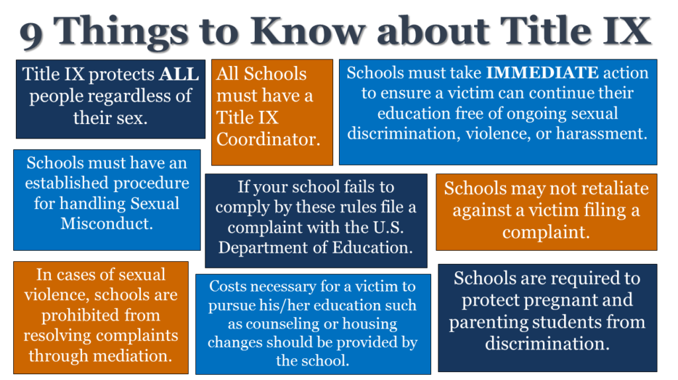

Slide 4
Title IX
The language contained in Title IX legislation indicates that schools must give all students who might be, are or have been pregnant (whether the student is a parent or not) the same access to school programs and extracurricular activities that other students have.

Slide 5
Student Disclosure
Must disclose need to instructor.
Must apply with Title IX Deputy Coordinator.
Instructor will receive form letter from Deputy Coordinator.
DO NOT ATTEMPT TO DIAGNOSE A STUDENT

Slide 6
Student Disclosure
Please note that students who do not disclose until after a medical need determination has been made by the treating professional, students will not qualify for retroactive services

Slide 7
Diagnostic Statement
The signed diagnostic statement on letterhead from the treating health care professional must include the following information:
Diagnosis – date of onset, end date of services, original diagnosis, and description of present symptoms.

Slide 8
Diagnostic Statement
A description of the current functional impact on the student within the academic setting.
A description of the expected prognosis.
Credentials of the diagnosing professional including certification, licensure, professional training.

Slide 9
Excused Absences?
If a student has been properly identified, the absence will be excused.
You Must work with the student.

Slide 10
What Does This Mean?
Must allow student to make up work.
Must give opportunity to earn points.
Must provide any information given. during the excused absence(s) period.
Exceptions.

Slide 11
FAQ’s
Does my school have to excuse my absences due to pregnancy, childbirth or abortion?
Temple College must excuse your absences due to pregnancy or any related conditions for as long as your doctor says it is necessary for you to be absent. This is true even if there is no leave policy for students with other conditions. When you return to school, you must be reinstated to the status you held before your leave. The school can require you to submit a doctor’s note from you only if that is required of students with other medical conditions.

Slide 12
FAQ’s
My professor adjusts grades based on class attendance. Can she lower my grade because of the classes I miss?
A student cannot be penalized for pregnancy or related conditions. If a professor provides specific “points” or other advantages to students based on class attendance, you must be given the opportunity to earn back the credit from classes you miss due to pregnancy, so that you can be reinstated to the status you held before you took leave.

Slide 13
FAQ’s
Does my school have to let me make up the work I missed while I was absent?
Yes, Temple College must let you make up the work you missed while you were out due to pregnancy or any related conditions, including recovery from childbirth. For example, if you have a doctor’s note that excuses you from class for several weeks because you were on “bed rest” before giving birth, your school has to provide you with the appropriate assignments and information to make up all of the work you would have been required to complete while you were out. For an extended absence, it is best if your school provides you with the work you miss regularly, so you do not fall far behind

Slide 14
Where to find This Information
OCR states information must be readily available to students
Student Handbook/Safety and Emergency Information

Slide 15
Where…Continued
*”Note: Students who are enrolled in courses that have a clinical, externship, internship, or laboratory experience in an outside agency may not be able to have services provided at these agencies. Outside agencies are not bound by the Temple College Title IX Policy; the agency policy will supersede Temple College policy in those locations.”
This is not correct and will be removed from the website and handbook

Slide 16
Questions????

Slide 17
Title IX
Randolph P. Baca Ed.D
Title IX Coordinator
Marc A. Nigliazzo Administration Building,
Human Resources Office
254.298.8582
August 22, 2017

Slide 18
Title IX
Title IX is one component of a set of components of federal legislation introduced in the 1960’s and 1970’s to address discrimination. We are subject to the legislation that affects higher education.

Slide 19
Is Title IX For Athletics Only?
The original, federal legislation was focused on sex discrimination in admissions at colleges and universities. It was expanded to include sports programs.

Slide 20
What Federal Agency Oversees Title IX?
Currently, the Department of Education-Office for Civil Rights (OCR) oversees the adoption and interpretation of policy.

Slide 21
Title IX
Title IX of the Education Amendments of 1972 prohibits discrimination based on sex in education programs and activities in federally funded schools at all levels.
If any part of a school district or college receives any federal funds for any purpose, all of the operations of the district or college are covered by Title IX.

Slide 22
Title IX
Office for Civil Rights (OCR) Jurisdiction
Five (5) topics we are focusing on include:
1. Harassment and Bullying
2. Sex Based Harassment
3. Pregnancy or Parental Status
4. Retaliation
5. Athletics

Slide 23
In the Classroom
1. Ensure that all students are treated equally.
2. Avoid preferential treatment.
3. Allow the student to self-identify.
4. Intervene if bullying or harassment is taking place. If you feel you may be injured if you intervene, contact the Campus Police Immediately.

Slide 24
In the Classroom
5. If the student is a victim of bullying/harassment and they have confided in you, contact me and provide the names of the students involved.
6. If a student confides in you that they have been a victim of sexual violence, contact the Campus Police immediately.
6. Finally, do not bully, harass, or sexually harass anyone!!

Slide 25
Title IX
Office for Civil Rights Jurisdiction
Sex-based Harassment
There are two forms of sex-based harassment:
1. Sexual harassment (including sexual violence).
http://www.templejc.edu/wp-content/uploads/2014/10/Preventing_Sexual_Harassment.pdf
http://templejc.edu/wp-content/uploads/2015/02/Title-IX-and-Sexual-Violence.pdf
2. Gender based harassment.

Slide 26
What is the Clery Act?
The Clery Act requires colleges and universities, both public and private, participating in federal student aid programs to disclose campus safety information, and imposes certain basic requirements for handling incidents of sexual violence and emergency situations.
The Clery Act is named in memory of Jeanne Clery.
Temple College Security and Crime Statistics URL:
http://templejc.edu/resources/campus-police/security-and-crime-statistics/

Slide 27
Title IX
Office for Civil Rights Jurisdiction
Harassment and Bullying
This includes:
1. Verbal actions and name-calling.
2. Graphic and written statements (Cell phones and the internet).
3. Other conduct that may be physically threatening, harmful or humiliating.

Slide 28
Title IX
Office for Civil Rights Jurisdiction
Pregnancy or Parental Status
Title IX prohibits a school from discriminating against a student based on the student’s pregnancy, childbirth, false pregnancy, termination of pregnancy or recovery from any of these conditions.

Slide 29
Title IX
Office for Civil Rights Jurisdiction
Retaliation
If a claim has been filed, an employee of Temple College cannot intimidate, threaten, coerce or discriminate against this individual for the purpose of interfering with any right or privilege secured by filing a claim through OCR.

Slide 30
Title IX
Office for Civil Rights Jurisdiction
Athletics
Since Temple College runs an Athletic Program, the College must provide equal athletic opportunities for members of both sexes. This includes equivalent benefits, scholarship opportunities, treatment, equipment and supplies, game and practice time and any other athletic requirement.

Slide 31
Title IX
Office for Civil Rights Jurisdiction
A student does not have to file a claim with the College. The student can file a claim directly with the Office for Civil Rights (OCR).

Slide 32
References
Department of Education, Office for Civil Rights (2015). Title IX Resource Guide, U.S. Department of Education, Office for Civil Rights. Retrieved July 25, 2016 from http://www2.ed.gov/about/offices/list/ocr/docs/dcl-title-ix-coordinators-guide-201504.pdf
Temple College (2016). Policy Manual. Retrieved August 1, 2016 from http://templejc.edu/about/policy-manual/

Slide 33
Questions????

